Slide 1
Function design M9
03-11-2023

Slide 2
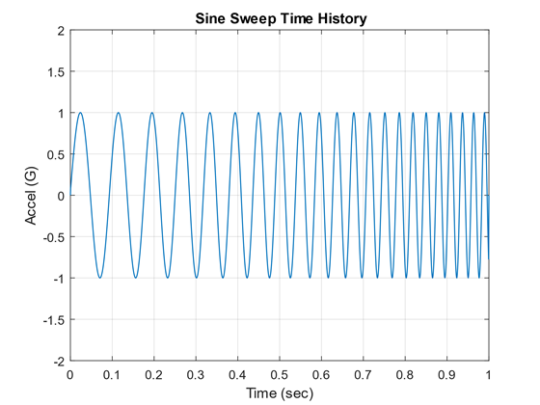
Traditionele sine sweep

Slide 3
Onze frequentie range
Wij willen in de breedste setting frequenties tussen de 5 kHz en 100 kHz meten. Onder de 5 kHz hoeft niet dus de langst durende frequentie duurt maar 0.2 ms en dit gaat hard omlaag.

Slide 4
PWM Frequency
(F)
(N) Burst measuring cycles
Amount of pulses (Y)
Microphone amplification factor (B)
Wait between bursts (X)
Pulse amplification factor (A)
Pulse 1
Pulse N
PWM instruction
Sine instruction
Function: PWM_Burst(F,X,Y,N,A,B)
Function: Sine_Burst(Fmin, Fmax,R, N,A,B)
Min. Frequency (Fmin)
Max. Frequency (Fmax)
Pulse amplification factor (A)
Wait 5 ms between bursts
Microphone amplification factor (B)
Sweep 1
Sweep N
Sweep duration (15 ms)
Amount of repetitions (R), here shown as 1
N Sweep measuring cycles

Slide 5
Parameter max-min values: Sine
Vast: 15 ms sweep, 5 ms wachten tussen sweeps
A: Voltage ranges from 0-10 V
B: To amplify Infineon mic (-73 dB noise level)
N: Maximum of 10
R: 1 to 5 repetitions
Fmin: 5 kHz
Fmax: 100 kHz

Slide 6
Time-of-flight meting
M91200 X Plense

Slide 7
PWM Frequency
(Fres)
(N) Burst measuring cycles
Microphone amplification factor fixed
Pulse amplification factor fixed
Wait between bursts (X)
Pulse 1
Pulse N
TOF instruction
Sine instruction
Function: TOF(Fres,X,N)

Slide 8
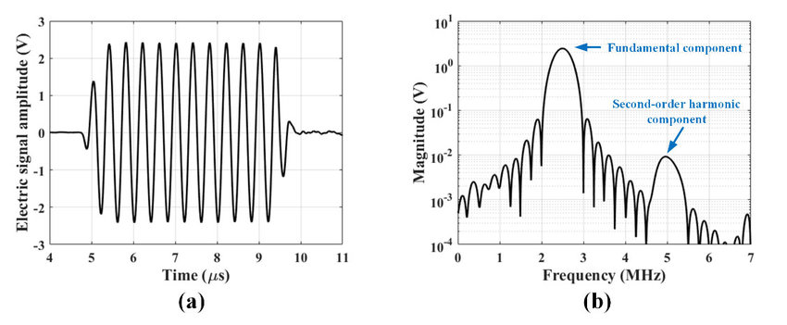
Tone burst
(F) Frequency
(N) pulses
(A) amplification
factor
Amount of repetitions (R), wait time between repetitions: 10 ms

Slide 9
Next step
Calculate the average over the repetitions

